Slide 1
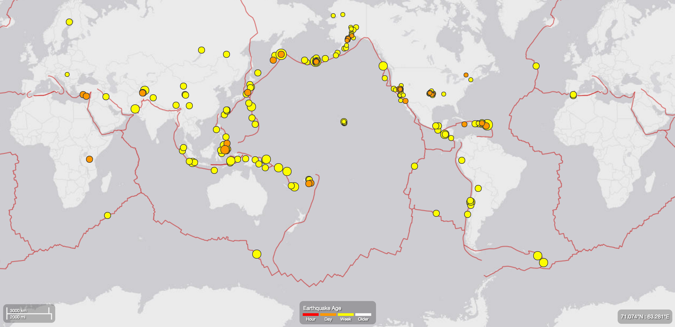
Time series analysis & anomaly detection
image source: http://earthquake.usgs.gov/earthquakes/map/

Slide 2


Who am I?
Brian Kent, data scientist
PhD in statistics from CMU.
Research in density estimation and clustering.
GLC toolkits for unsupervised machine learning.
brian@dato.com
brianpkent.com
github.com/papayawarrior

Slide 3
The agenda
The goal: to discuss several aspects of time series analysis, to whet the appetite. A deeper dive on anomaly detection.
The agenda:
What is a time series?
TimeSeries, the data object
Basics of forecasting
Anomaly detection
Logistics:
90 minutes, ending at 12:30pm
Two breaks for questions, plus more at the end.
43 slides total + 3 code demos.

Slide 4
What is a time series?

Slide 5
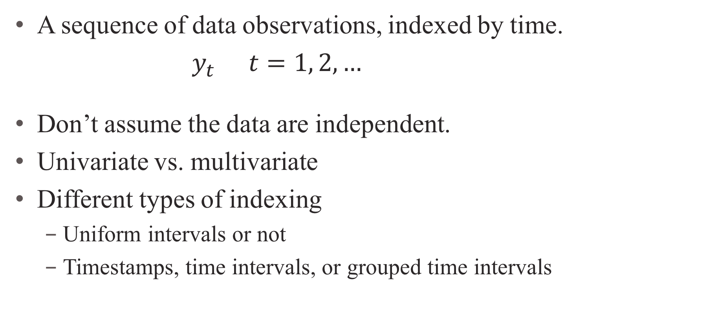
What is a time series?
A sequence of data observations, indexed by time.
$y_{t}$ $t=1, 2, …$
Don’t assume the data are independent.
Univariate vs. multivariate
Different types of indexing
Uniform intervals or not
Timestamps, time intervals, or grouped time intervals
Notes:
Time series is a simple concept, but notoriously tricky in practice. After all, even “time” is a hard concept to define.

Slide 6
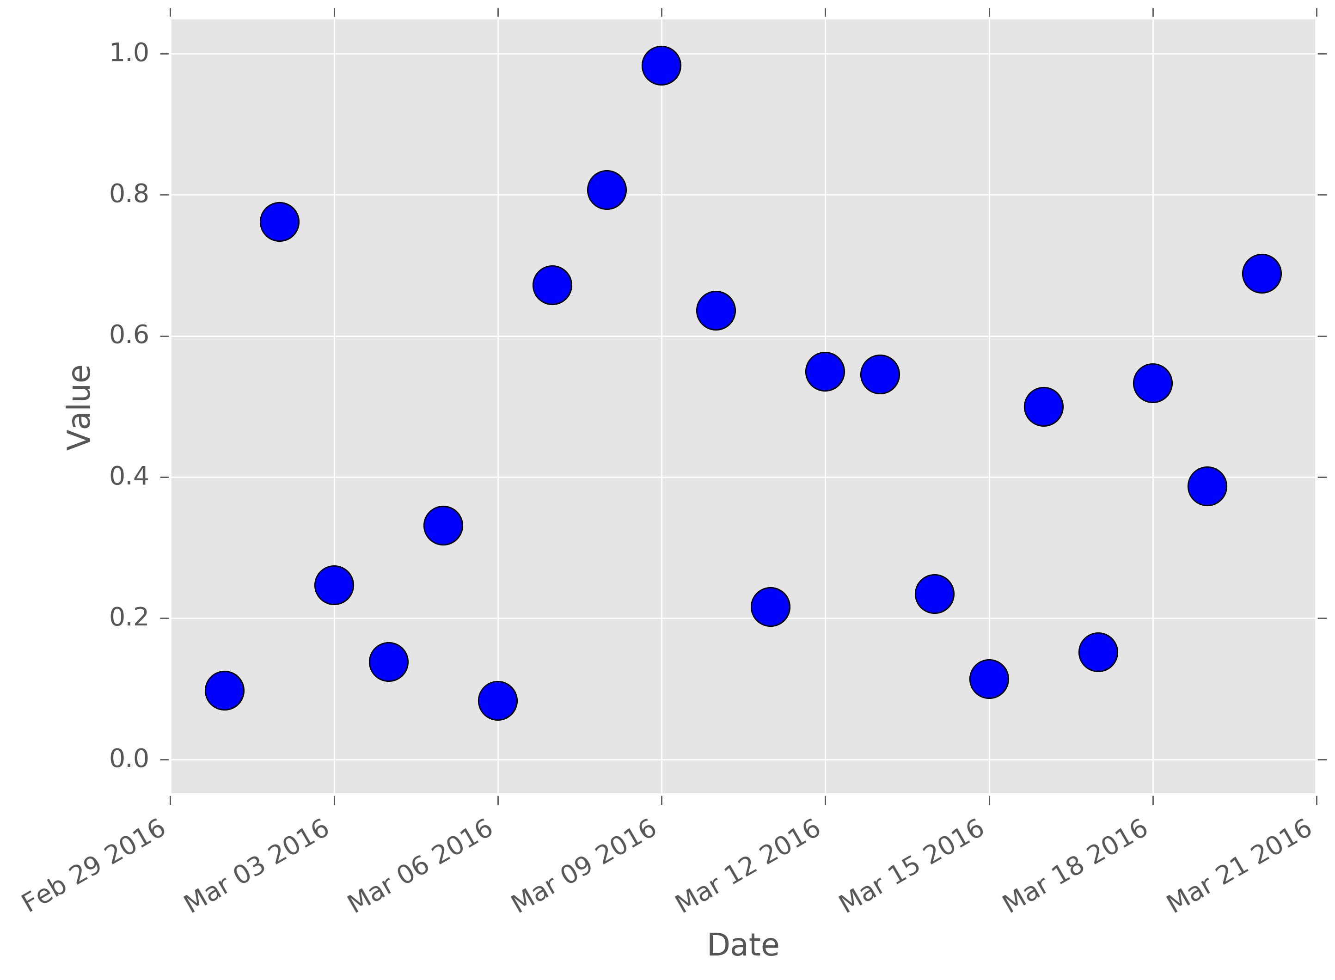
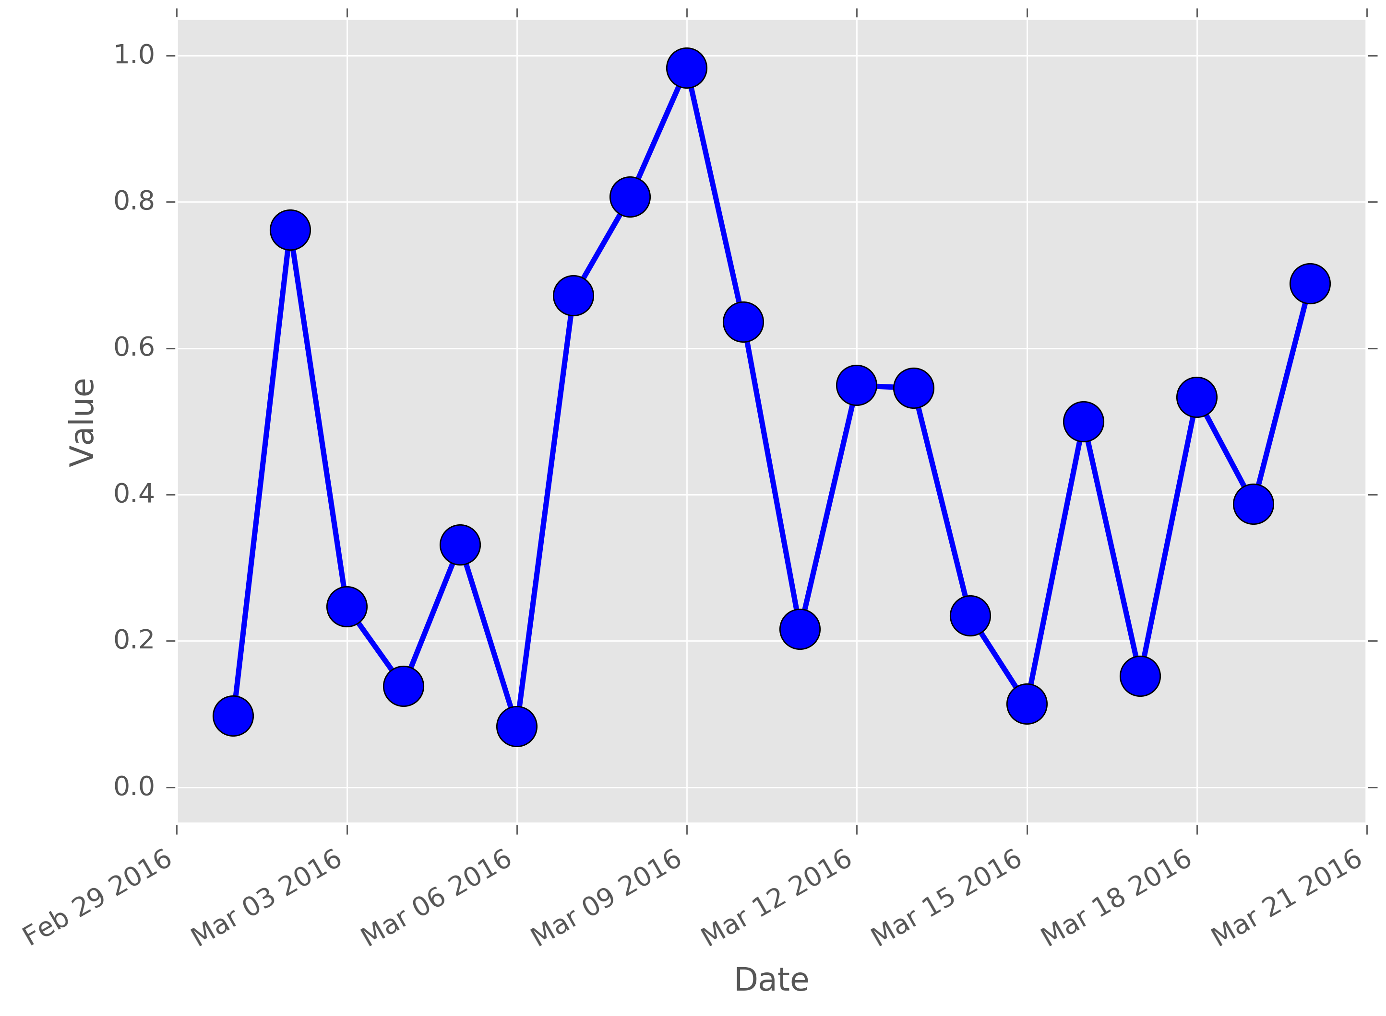
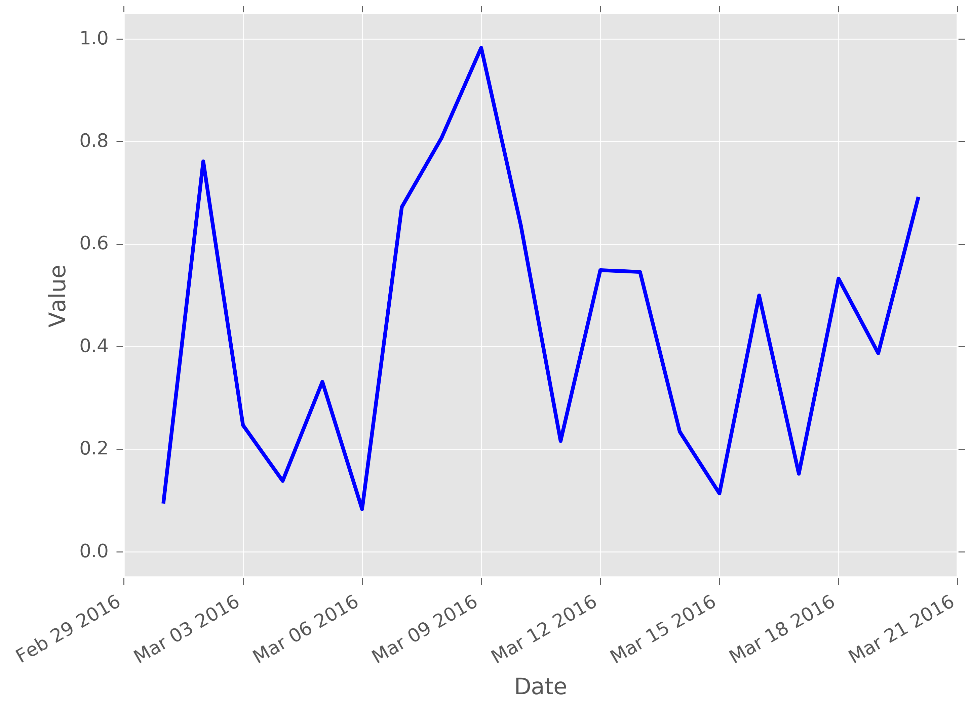
What is a time series?
+----------------+--------+
| timestamp | value |
+----------------+--------+
| 2016-03-01 ... | 0.0975 |
| 2016-03-02 ... | 0.7612 |
| 2016-03-03 ... | 0.2469 |
| 2016-03-04 ... | 0.1381 |
| 2016-03-05 ... | 0.3314 |
+----------------+--------+
[20 rows x 2 columns]

Slide 7
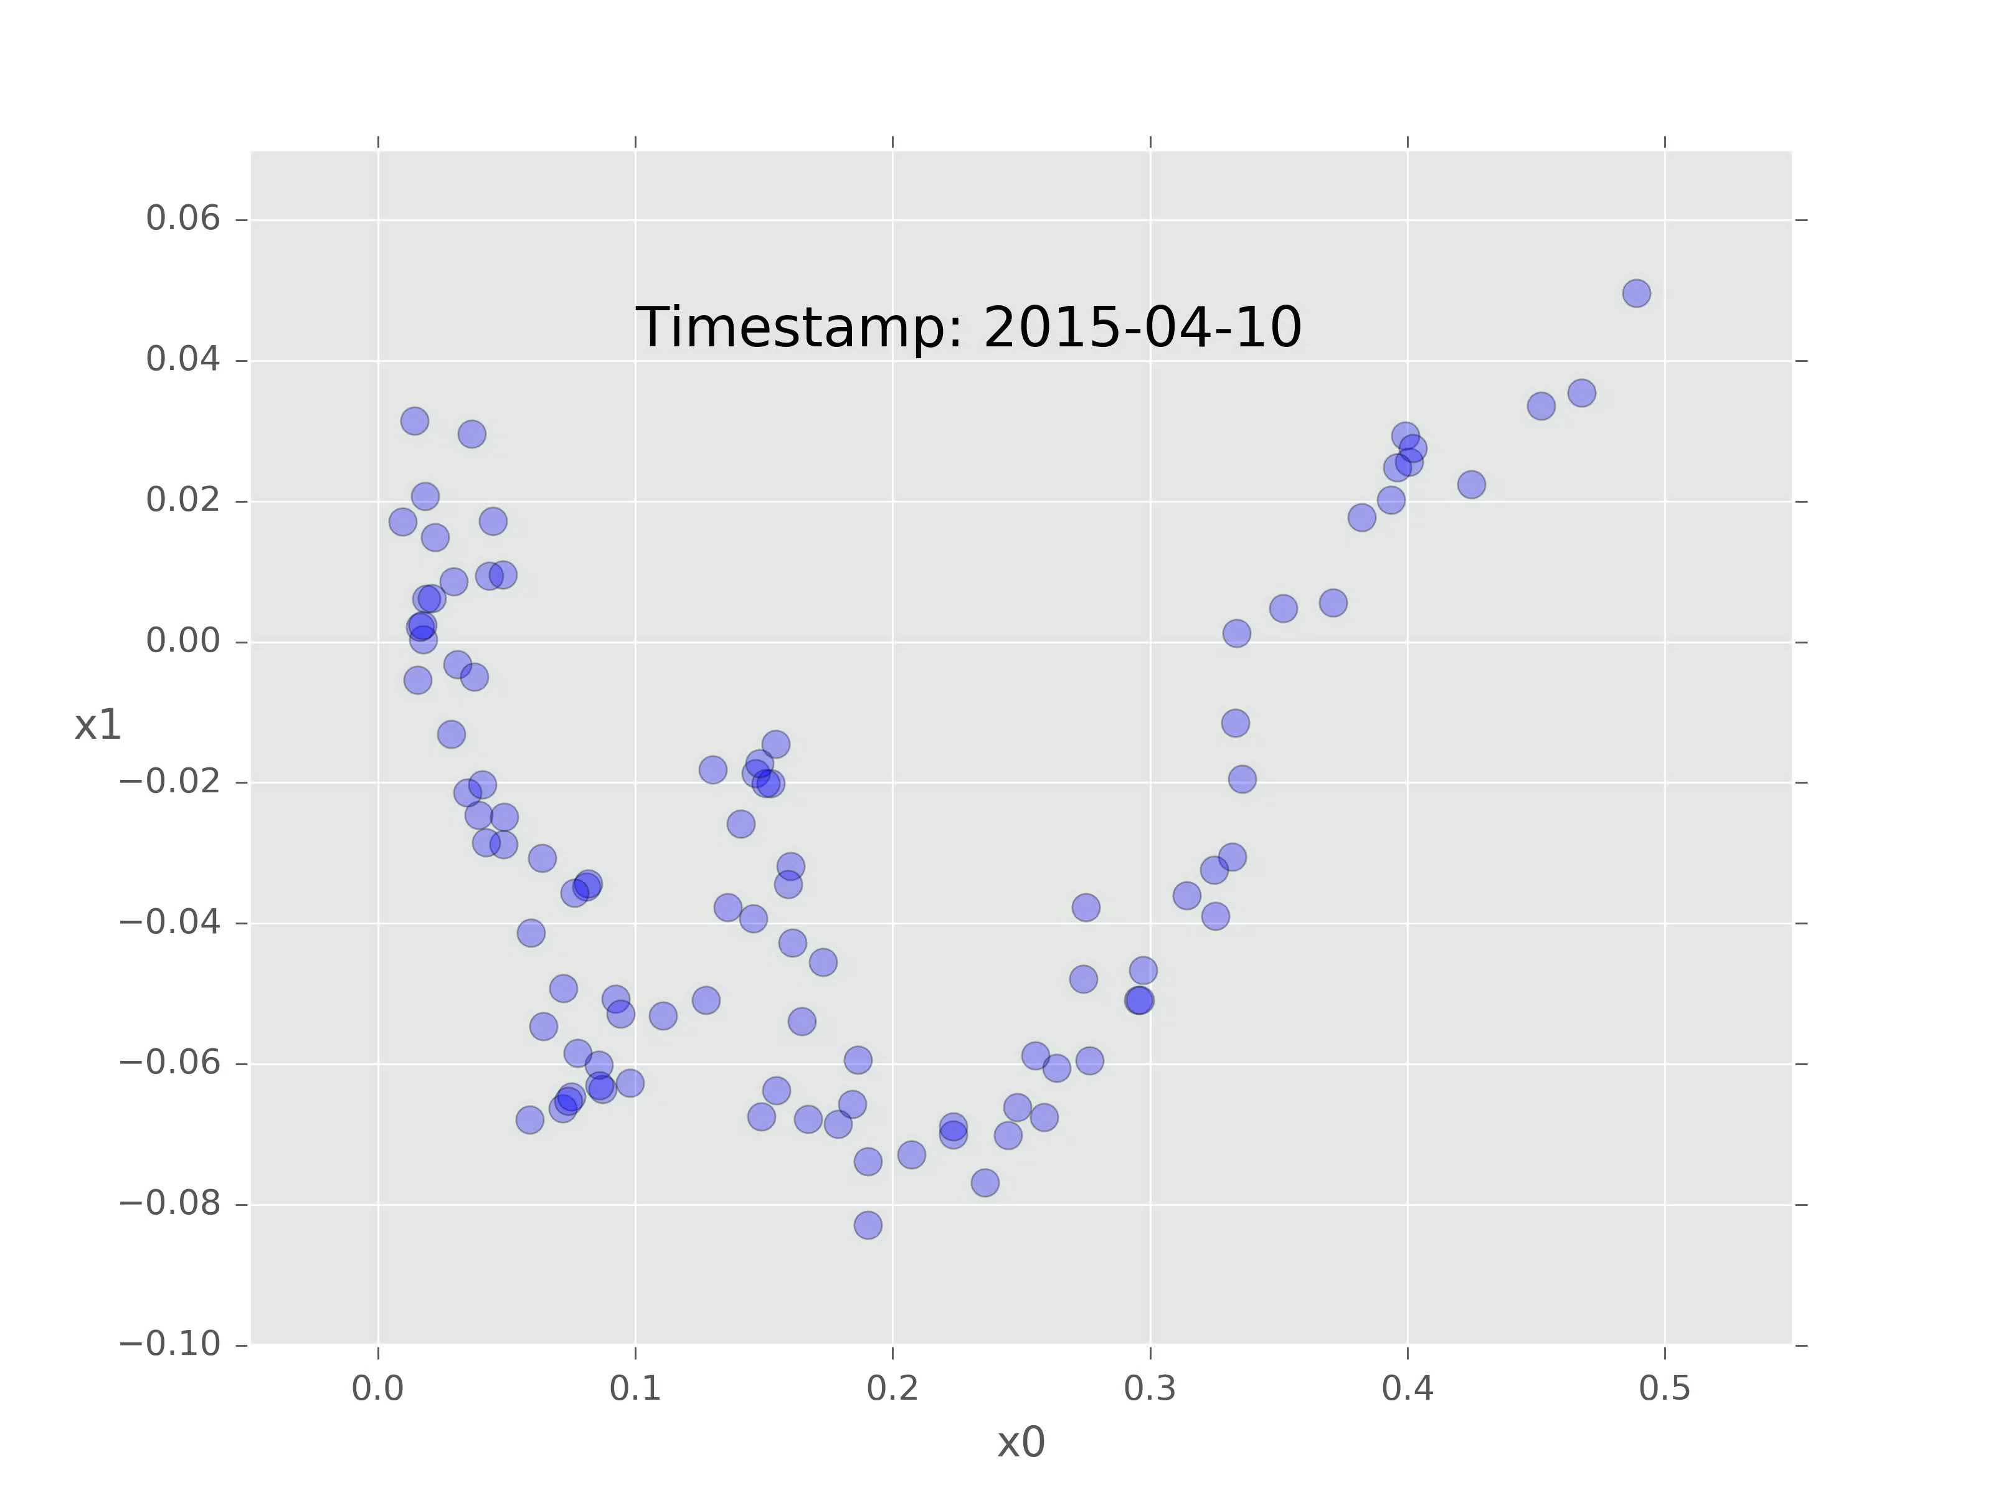
Multivariate time series
+----------------+--------+--------+
| timestamp | x.0 | x.1 |
+----------------+--------+--------+
| 2015-01-01 ... | 0.489 | 0.0495 |
| 2015-01-02 ... | 0.4678 | 0.0354 |
| 2015-01-03 ... | 0.4521 | 0.0335 |
| 2015-01-04 ... | 0.425 | 0.0224 |
| 2015-01-05 ... | 0.4007 | 0.0255 |
+----------------+--------+--------+
[100 rows x 3 columns]

Slide 8
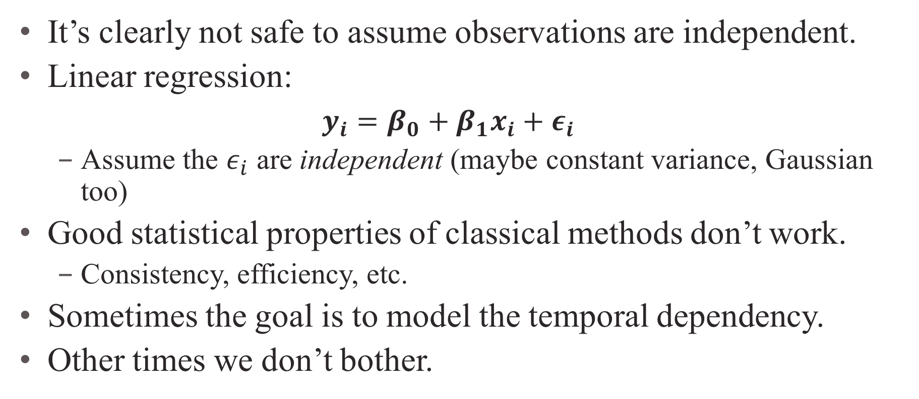
Why do we care about time series?
It’s clearly not safe to assume observations are independent.
Linear regression:
$y_{i}=β_{0}+β_{1}x_{i}+ε_{i}$
Assume the $ε_{i}$ are independent (maybe constant variance, Gaussian too)
Good statistical properties of classical methods don’t work.
Consistency, efficiency, etc.
Sometimes the goal is to model the temporal dependency.
Other times we don’t bother.

Slide 9
How do I work with a time series in code?

Slide 10
The GraphLab Create TimeSeries object
Inspired by Pandas time series
Backed by a single SFrame
Compressed, disk-backed data frame
Intelligent input parsing
Rich type support
Query optimization and lazy evaluation
Columnar architecture
Row indexing by sorted datetime values
Open source is the plan, but not yet

Slide 11
The scenario: understanding earthquakes
Kathryn Schulz, The Really Big One, The New Yorker, July 2015.
When the next full-margin rupture happens, [the PNW] region will suffer the worst natural disaster in the history of North America.
Kenneth Murphy, who directs FEMA’s Region X, the division responsible for Oregon, Washington, Idaho, and Alaska, says, ‘Our operating assumption is that everything west of Interstate 5 will be toast.’

Slide 12
Code demo: TimeSeries, the data object

Slide 13
How do I predict a new value in a time series?

Slide 14
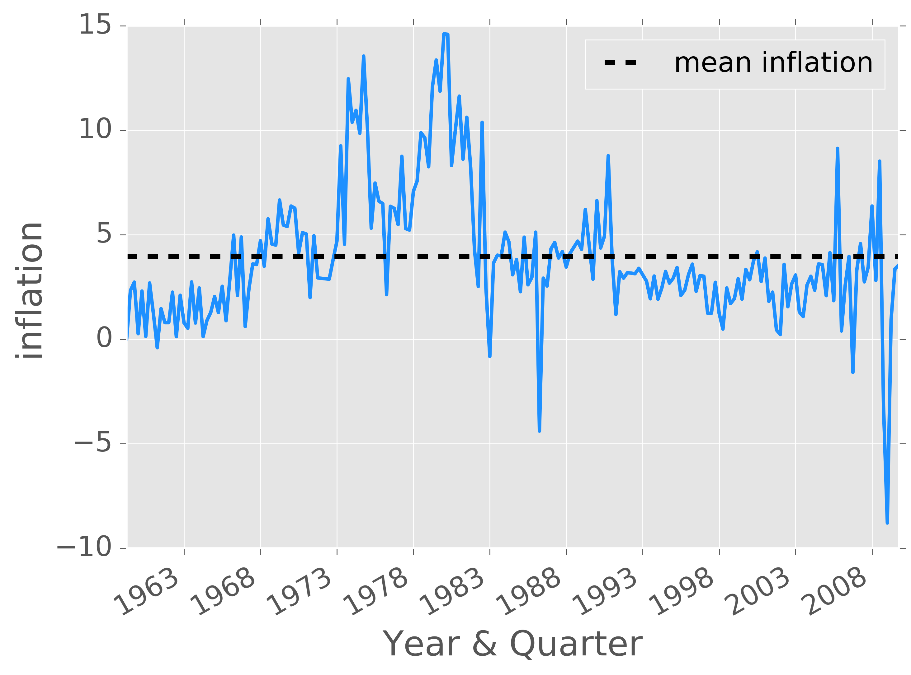
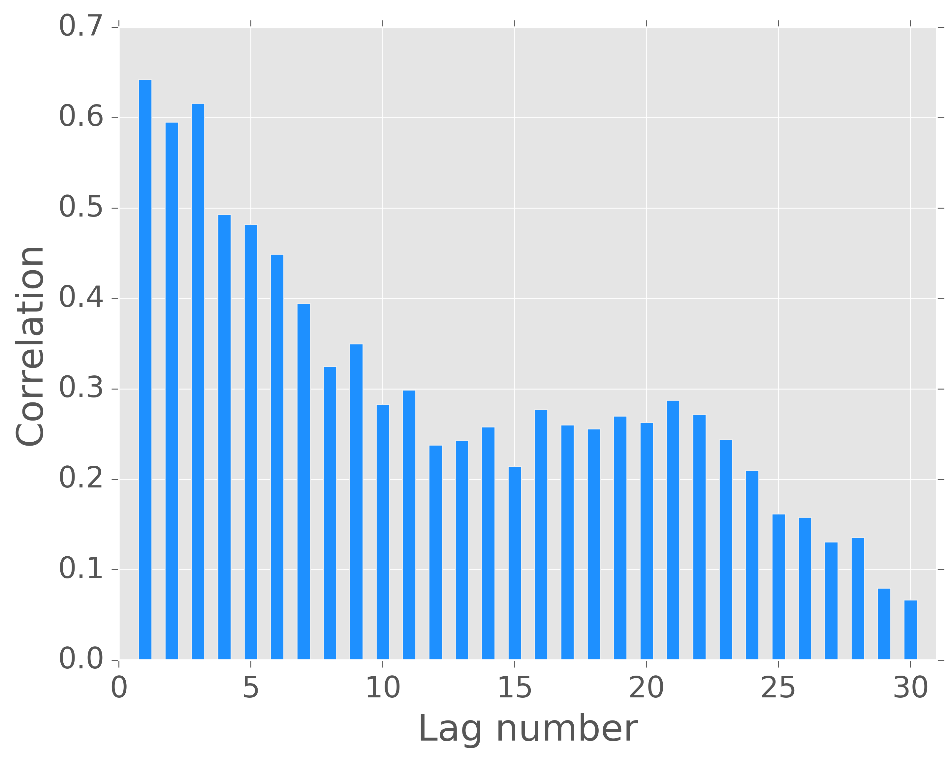
Basic modeling concepts
Autocorrelation: “…measures the linear relationship between lagged values of a time series.” (Hyndman, 2013)

Slide 15
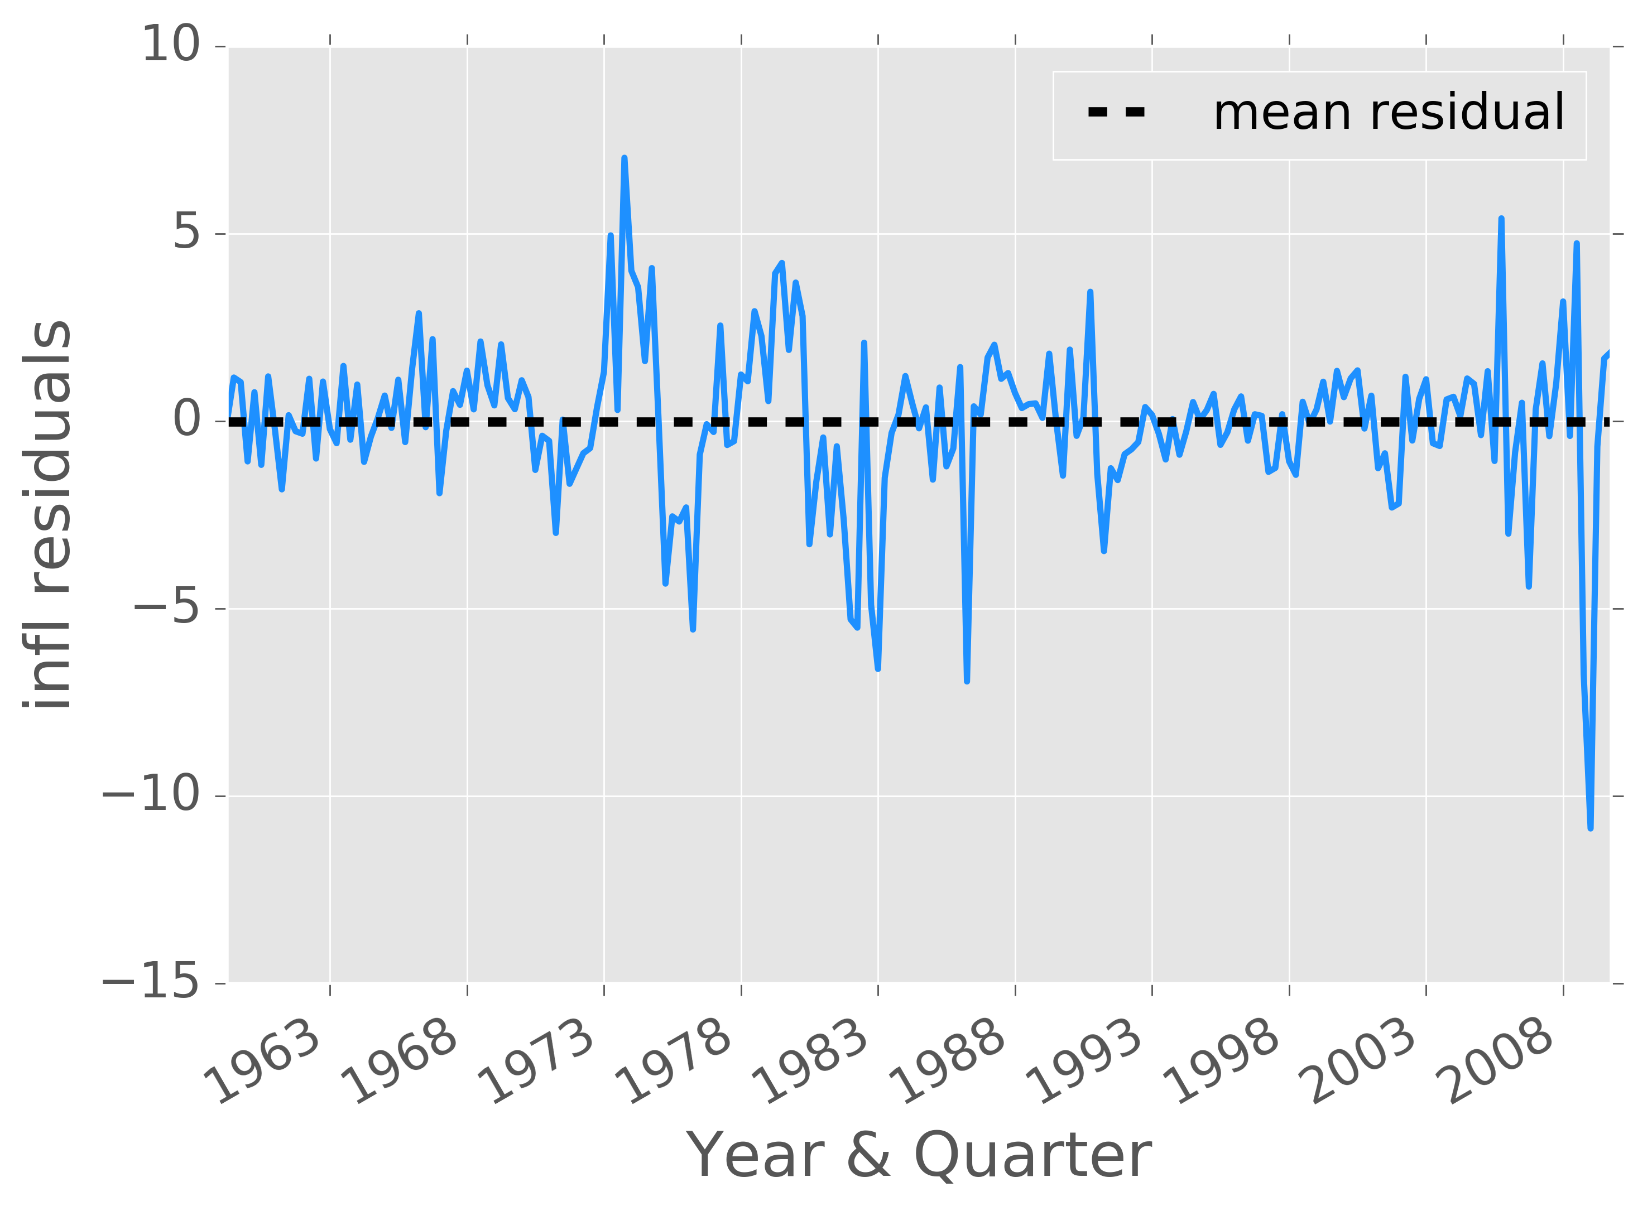
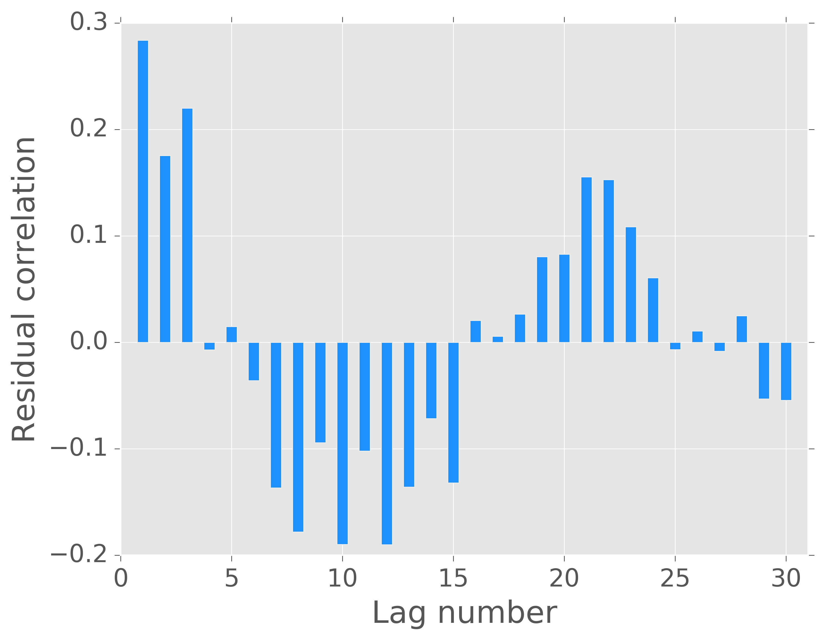
Basic modeling concepts
Autocorrelation: “…measures the linear relationship between lagged values of a time series.” (Hyndman, 2013)

Slide 16
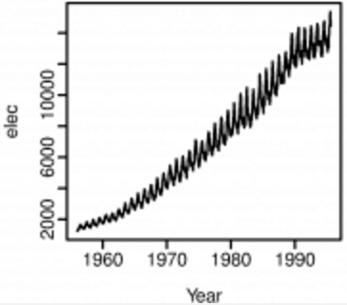
Basic modeling concepts
Stationarity: time series properties don’t change over time.
Constant mean, variance, and autocorrelations.
Series with trends or seasonality are not stationary.
A modeling assumption.
Stationary series can be modeled probabilistically.
NOT STATIONARY
image source: https://www.otexts.org/fpp/8/1

Slide 17
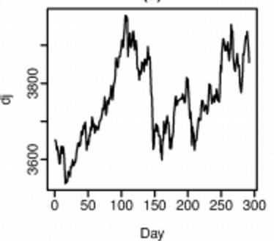
Basic modeling concepts
Stationarity: time series properties don’t change over time.
Constant mean, variance, and autocorrelations.
Series with trends or seasonality are not stationary.
A modeling assumption.
Stationary series can be modeled probabilistically.
NOT STATIONARY
image source: https://www.otexts.org/fpp/8/1

Slide 18
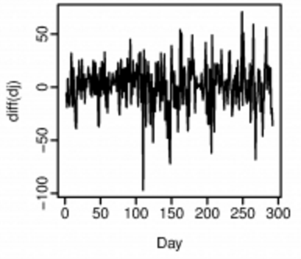
Basic modeling concepts
Stationarity: time series properties don’t change over time.
Constant mean, variance, and autocorrelations.
Series with trends or seasonality are not stationary.
A modeling assumption.
Stationary series can be modeled probabilistically.
STATIONARY!
image source: https://www.otexts.org/fpp/8/1

Slide 19

Forecasting model 1: auto-regression
Forecast tomorrow’s value from a weighted linear combination of the previous q values.
Tomorrow’s value
Today’s value
Yesterday’s value
$$y_{t}=β_{0}+β_{1}y_{t−1}+β_{2}y_{t−2}+ε_{t}$$
Error
Learn these weights from historical data

Slide 20
Forecasting model 1: auto-regression
Forecast tomorrow’s value from a weighted linear combination of the previous q values.
Assume a stationary series.
Learn the weights like any other linear model.
Restrict the coefficients in various ways.

Slide 21
Forecasting model 2: gradient-boosted trees
Ignore the time dependency!
Forecast the target from many lagged covariates.
An ensemble of decision trees.
Iterative training: each new tree is fit to the current residuals.
Super successful in Kaggle competitions.
Performs well for time series forecasting.
GraphLab Create provides a Python wrapper of XGBoost.

Slide 22
Code demo: basics of forecasting

Slide 23
How do I detect anomalies in a time series?

Slide 24
What are data anomalies?
“…patterns in data that do not conform to expected behavior.”
- Chandola, et al. (2009)
A short definition with big questions:
What is expected behavior?
How do we define not conforming?
What are data patterns?

Slide 25
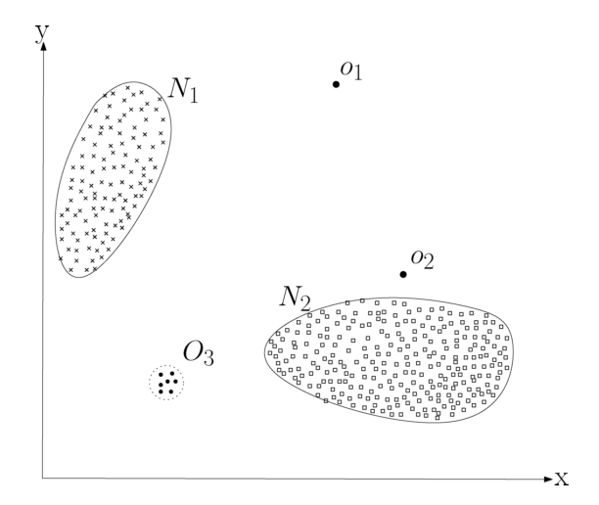
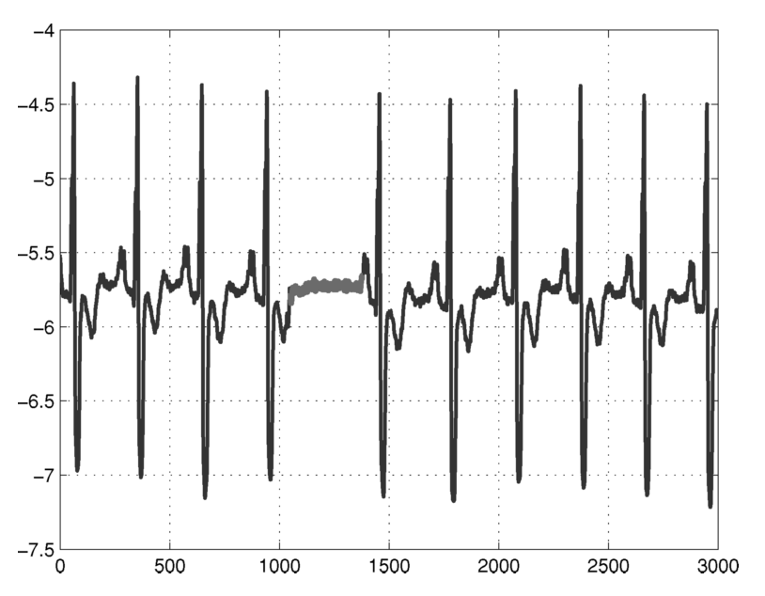
Examples of anomalies
Source: Chandola, et al. (2009)

Slide 26
Why bother with anomaly detection?
“…anomalies in data translate to significant, and often critical, actionable information…”
- Chandola, et al. (2009)
Usage metrics for product strategy
Customer usage for customized sales and marketing
Server load monitoring
Early warning for hardware failure
Medical imaging diagnostics
Etc, etc.
Oh, and better model fitting.

Slide 27
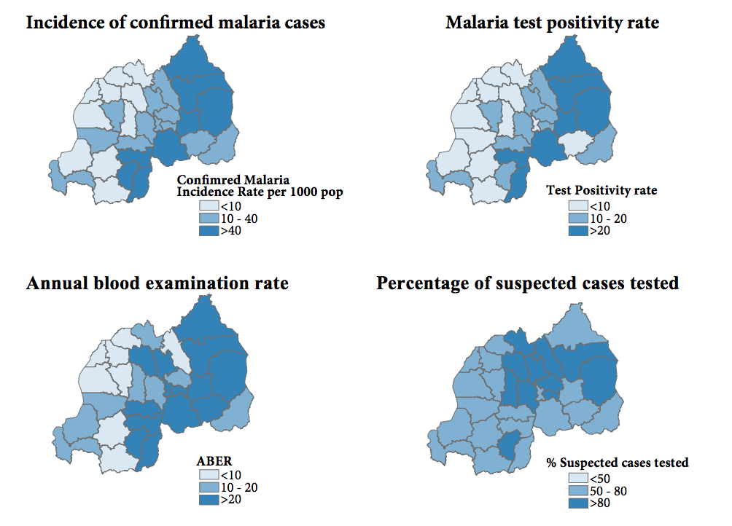
Examples of anomalies
Source: WHO Disease surveillance for malaria control and elimination (2012)

Slide 28
Image
Scope
Anomaly
type
Model
Supervision
Text
Graph
Outlier
Local outlier factor
Yes
Multivariate IID
Observations
Noise
No
DBSCAN
Small cluster
Data
type
Simple threshold
Outlier
Moving Z-score
Time Series
Change in mean
Within observations
Bayesian changepoints
A taxonomy of anomaly detection
Change in variance
Change in trend

Slide 29
The scenario
Image
Scope
Anomaly
type
Model
Supervision
Text
Graph
Outlier
Local outlier factor
Yes
Multivariate IID
Observations
Noise
No
DBSCAN
Small cluster
Data
type
Simple threshold
Outlier
Moving Z-score
Time Series
Change in mean
Within observations
Bayesian changepoints
Change in variance
Change in trend

Slide 30
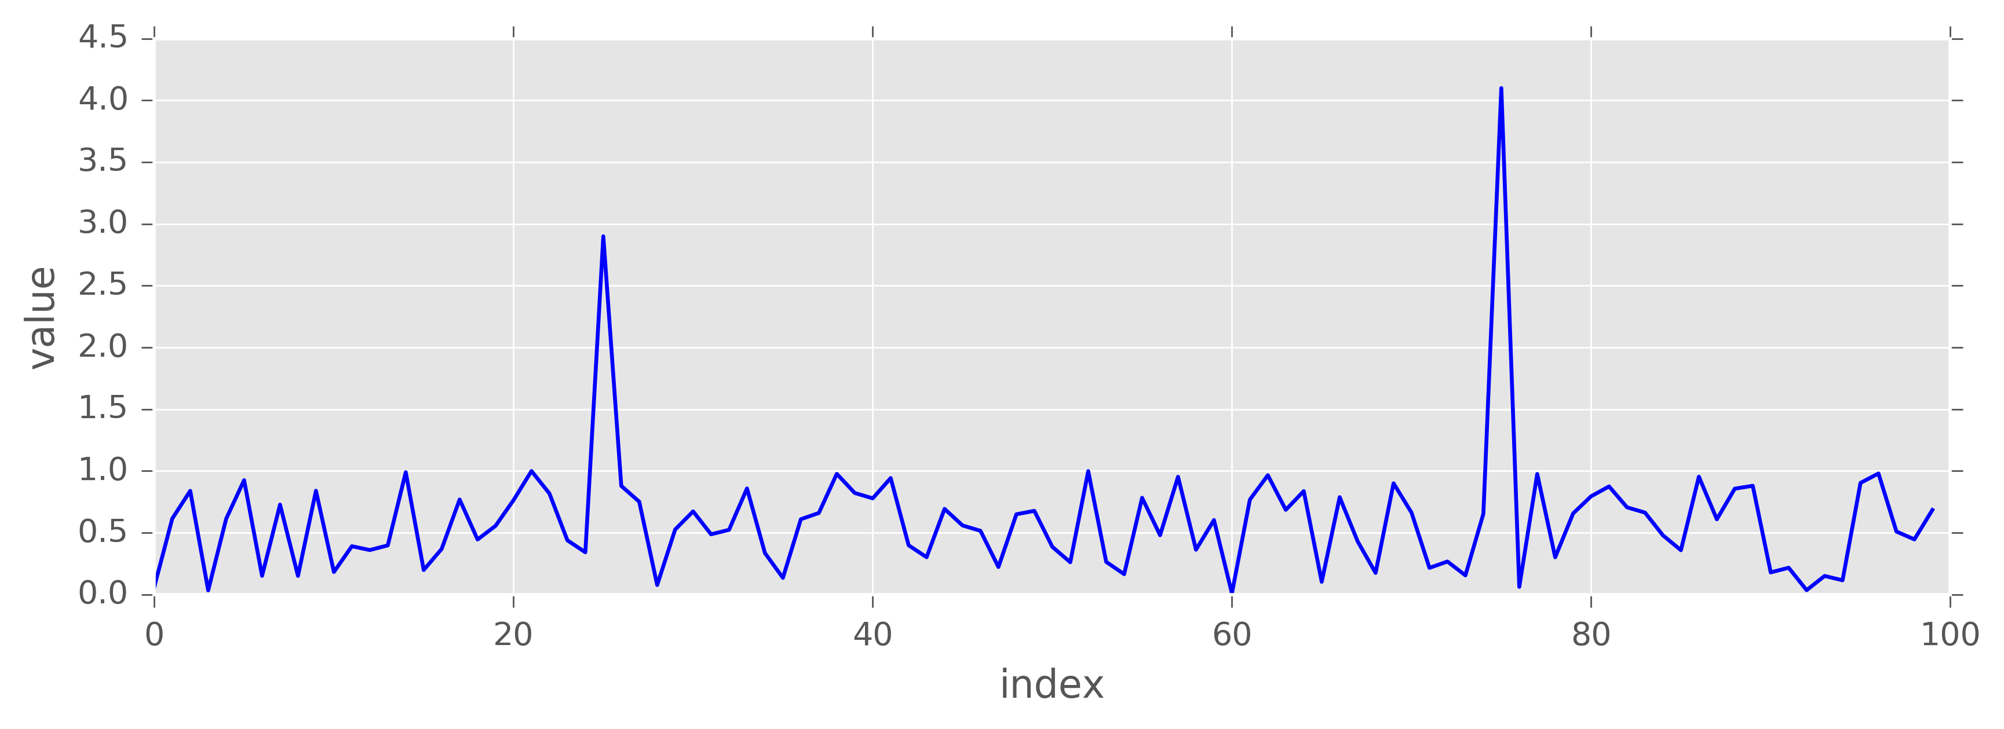
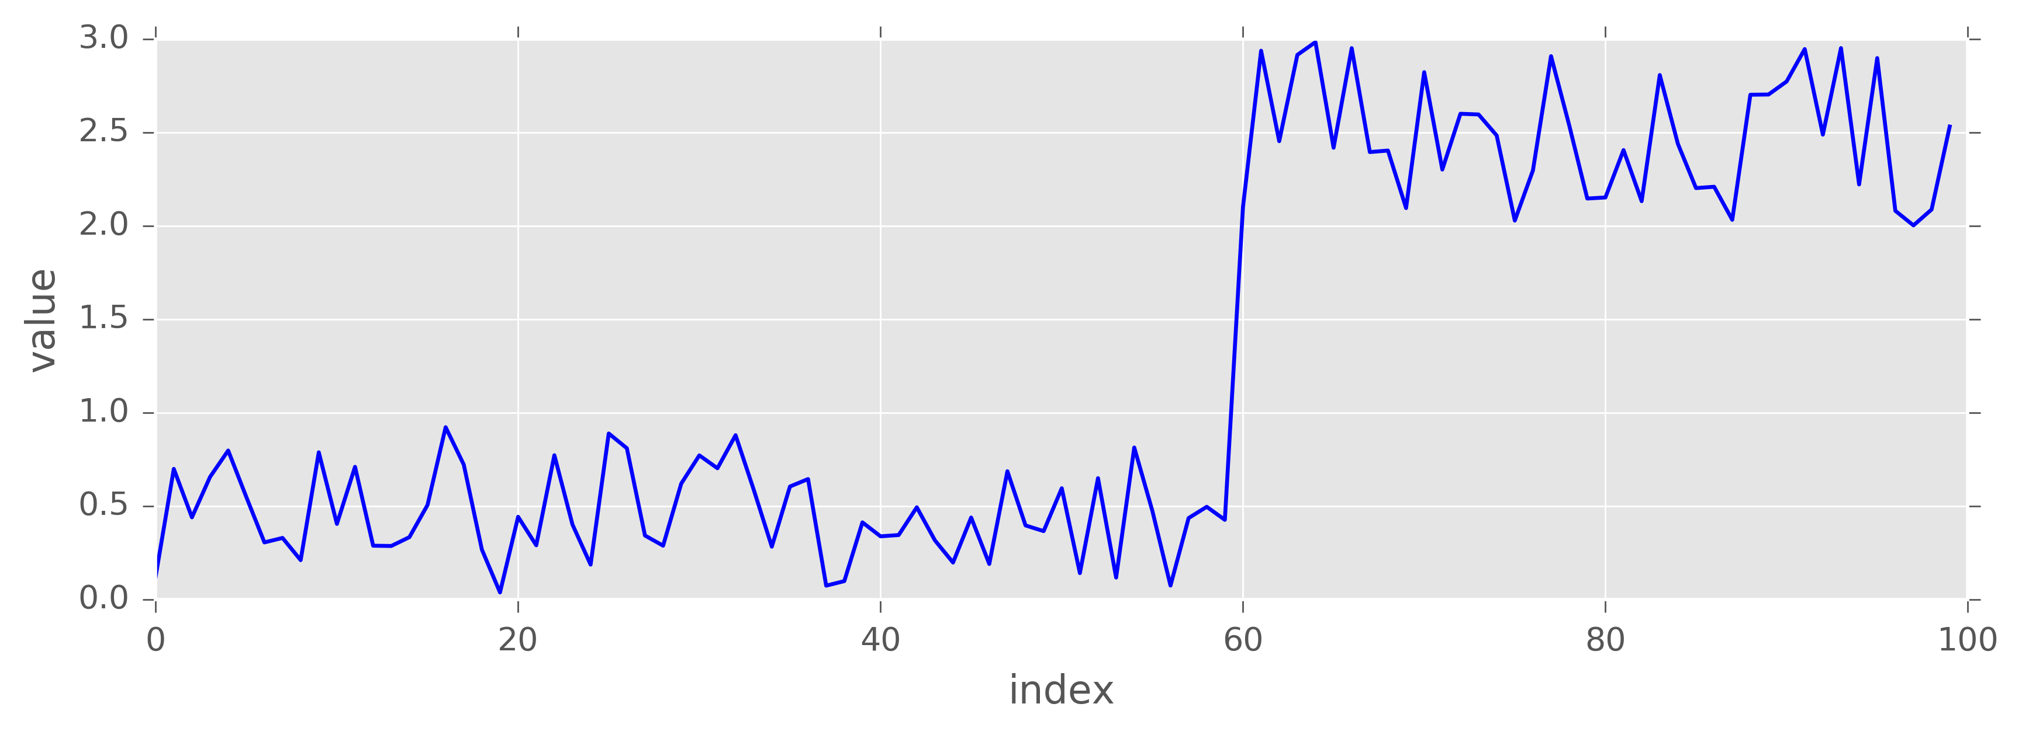
Anomaly type: time series (within observation)
Outliers
Mean shift

Slide 31
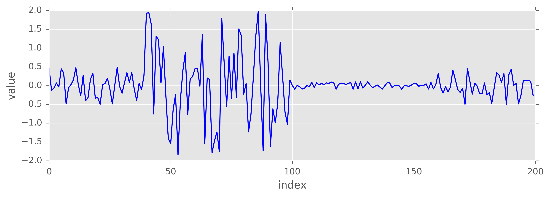
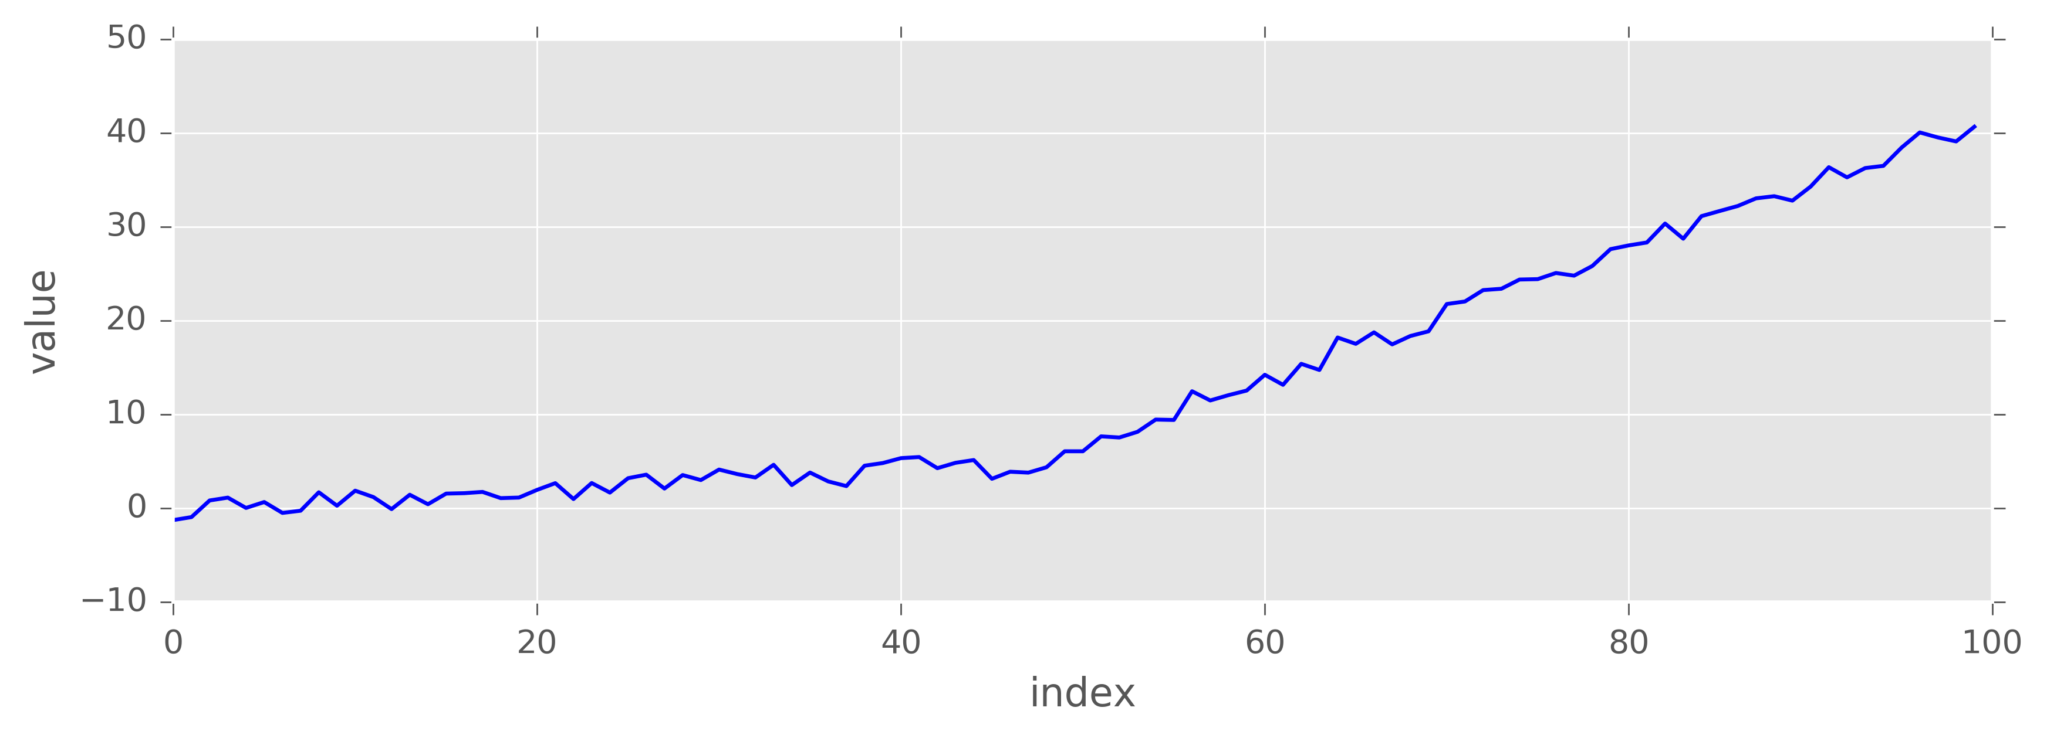
Anomaly type: time series (within observation)
Variance shift
Trend shift

Slide 32
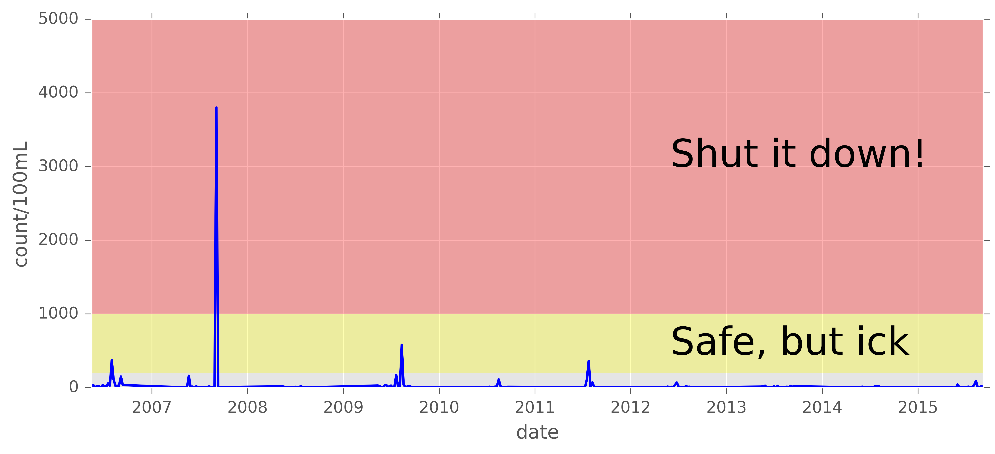
Model 1: the simple threshold
Any value greater than q is an anomaly.
Works great for physical processes with known thresholds.
Fecal coliform at Madrona Beach, Seattle

Slide 33
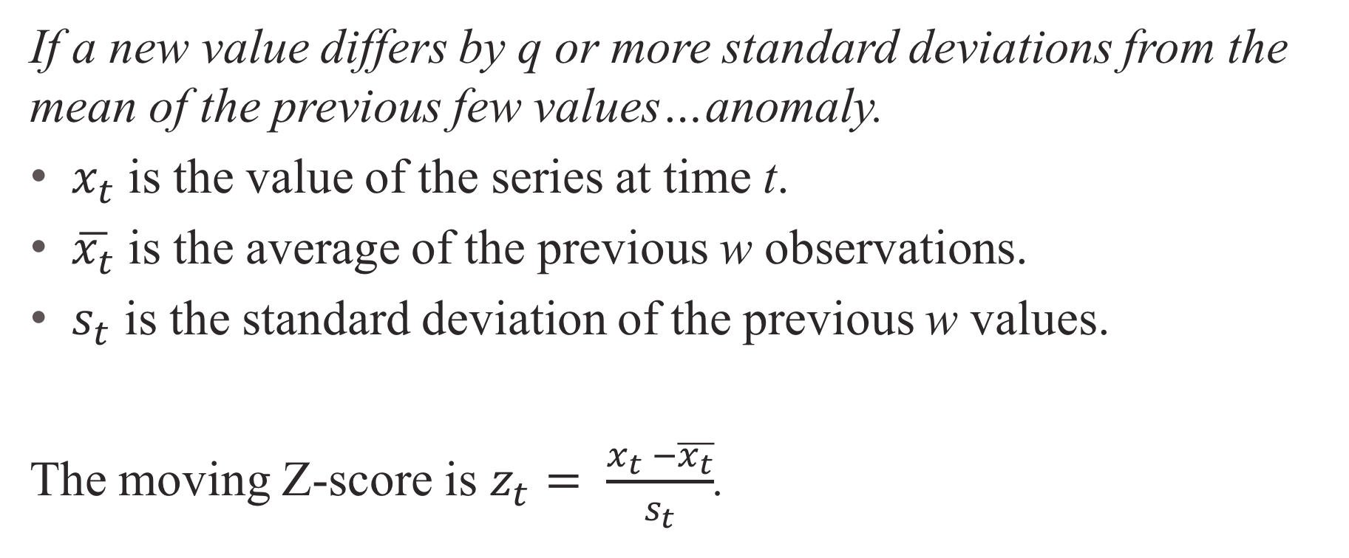
Model 2: moving Z-score
If a new value differs by q or more standard deviations from the mean of the previous few values…anomaly.
$x_{t}$ is the value of the series at time t.
$\overline{x_{t}}$ is the average of the previous w observations.
$s_{t}$ is the standard deviation of the previous w values.
The moving Z-score is $z_{t}= \frac{x_{t} −\overline{x_{t}}}{s_{t}}$.

Slide 34
Model 2: moving Z-score
The good:
Very fast, simple, explainable.
Data driven, so we’re not locked into a single threshold.
Handles long-term trends well.
Handles seasonality ok.
The not-so-good:
What window size?
Not very sophisticated. Can’t find decreases in variance.

Slide 35
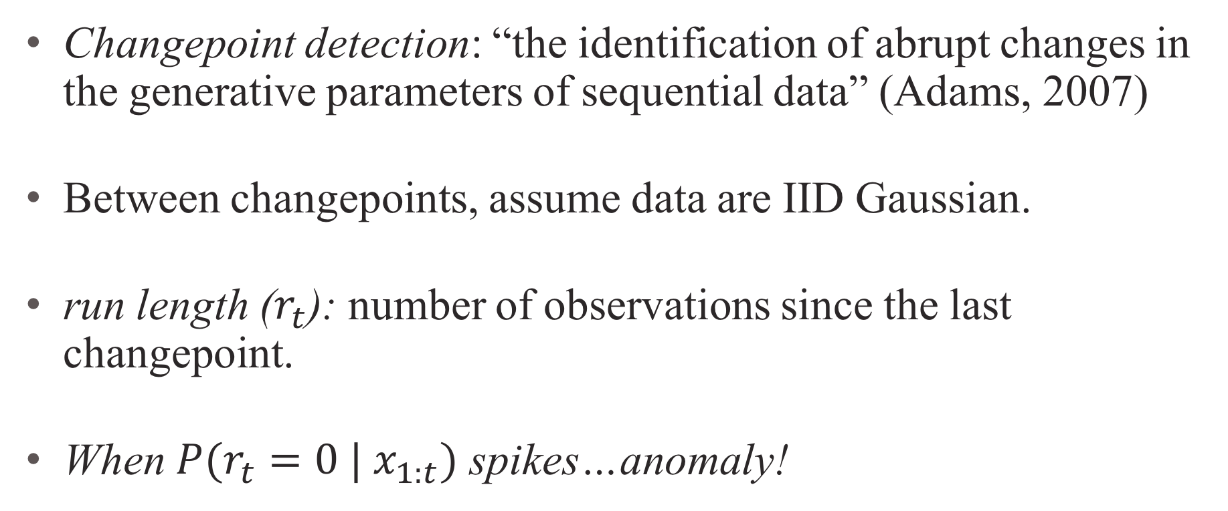
Model 3: Bayesian changepoint detection
Changepoint detection: “the identification of abrupt changes in the generative parameters of sequential data” (Adams, 2007)
Between changepoints, assume data are IID Gaussian.
run length ($r_{t}$): number of observations since the last changepoint.
When ${P(r}_{t}=0 | x_{1:t})$ spikes…anomaly!

Slide 36
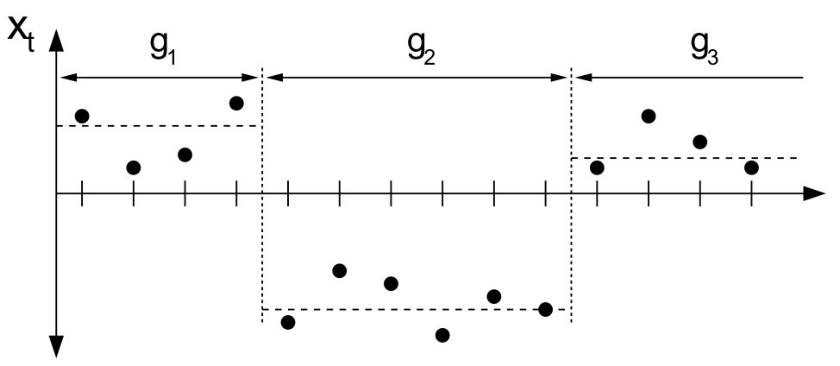
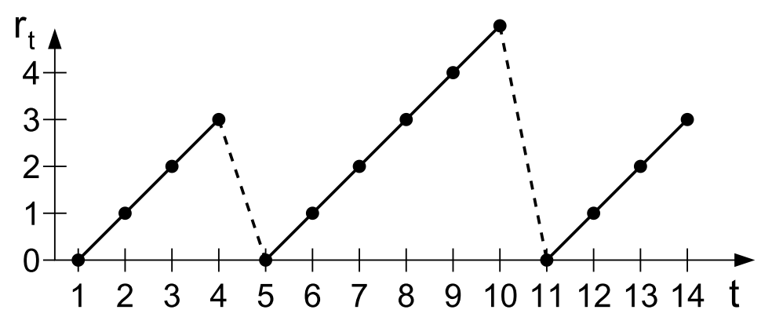
Model 3: Bayesian changepoint detection
Points from three regimes.
Run length at each point (deterministic)
Source: Adams & MacKay (2007)

Slide 37
Model 3: Bayesian changepoint detection
The good:
Detects changes in mean and variance.
Very fast.
Result is a probability.
Trade detection accuracy and speed with the lag parameter.
The not-so-good:
What prior on the run length?
Assumes data is Gaussian between changepoints.
Less explainable.

Slide 38
Anomaly detection in GraphLab Create
Between heavy, expensive GUI tools and doing it from scratch.
Choose a specific model, or let the top level do it for you.
Leverage the tools in SFrame and GraphLab Create.
Uniform interface across the toolkit.
Models can be updated with new data.

Slide 39
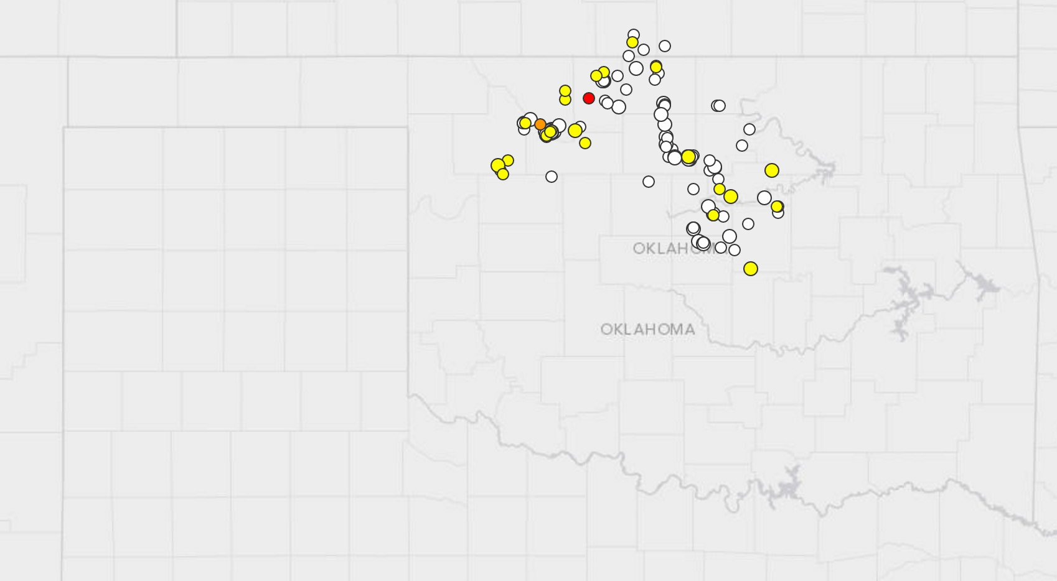
Oklahoma earthquakes?
Oklahoma used to be a seismic afterthought….Today, however, Oklahoma is one of the most seismic places on the planet.
Time Magazine, March 2016
Seismologists have long warned that the rise in the number of earthquakes in Oklahoma could presage a temblor that could cause extensive damage. – New York Times, March 2016
image source: http://earthquake.usgs.gov/earthquakes/map/

Slide 40
Code demo: anomaly detection

Slide 41
That was long and I’m hungry; what are the main takeaways?

Slide 42
Conclusions
We need time series because we can’t assume independence.
Sometimes we assume it anyway.
Forecasting & anomaly detection extract valuable information.
GraphLab Create provides state-of-the art tools for time series data analysis.
One big open question: how to deploy these models?
“ML in Production” at 3:30pm.

Slide 43
Thank you!

Slide 44
References
Chandola, V., Banerjee, A., & Kumar, V. (2009). Anomaly Detection: A Survey. ACM Computing Surveys, 41(3), 1–58.
WHO operational manual: Disease surveillance for malaria control and elimination. (2012).
King County, Swimming beach bacteria and algal toxin levels, and water temperature.
Adams, R. P., & Mackay, D. J. C. (2007). Bayesian Online Changepoint Detection. arXiv:0710.3742v1
Wikipedia – time series: https://en.wikipedia.org/wiki/Time_series

Slide 45
References
Sanborn, J. (2016). The U.S.’s New Earthquake Capital: Oklahoma, Time.
Wines, M. (2016). Oklahoma Puts Limits on Oil and Gas Wells to Fight Quakes, New York Times.
Hyndman, R. and Athanasopoulos, G. (2013) Forecasting: principles and practice. https://www.otexts.org/fpp

